Slide 1




DGE–CRED Practice Session 1: Installation and Usage of Dynare
Andrej Drygalla, Katja Heinisch and Christoph Schult* | August 2020 Halle Institute for Economic Research
* Research assistance by Yoshiki Wiskamp is greatly acknowledged.

Slide 2



Outline
1
Installation of Dynare
2
Set path to Dynare in Matlab
3
Usage of Dynare

Slide 3
Outline
1
Installation of Dynare
Installation of Dynare: Introduction Installation of Dynare: Windows Installation of Dynare: macOS

Slide 4
1.1 Installation of Dynare: Introduction
Packaged versions of Dynare are available for:
► Windows (7, 8.1, 10)
► Several GNU/Linux distributions (Debian, Ubuntu, Linux Mint, Arch Linux)
► macOS 10.11 or later
► Should work on other systems, but some compilation steps are necessary
In order to run Dynare, you need one of the following:
► MATLAB version 7.9 (R2009b) or above
► GNU Octave version 4.2.1 or above, with the statistics package from Octave-Forge
For the DGE–CRED model only Dynare 4.6 and the latest Octave version are suitable

Slide 5
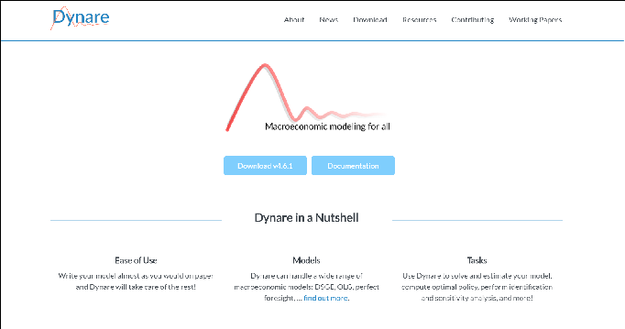
1.2 Installation of Dynare: Windows (1)
Access the Dynare web page (https://www.dynare.org) and click on “Download v4.6.1”:

Slide 6
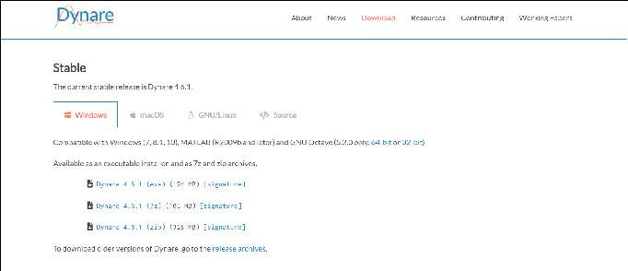
1.2 Installation of Dynare: Windows (2)
The following page will be displayed:
Click on “Dynare 4.6.1 (exe)” to download the executable installer.

Slide 7
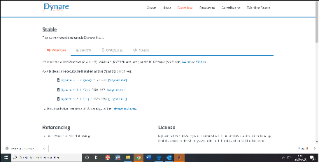
1.2 Installation of Dynare: Windows (3)
Open the downloaded executable installer “dynare-4.6.1.exe”
Follow the displayed instructions

Slide 8
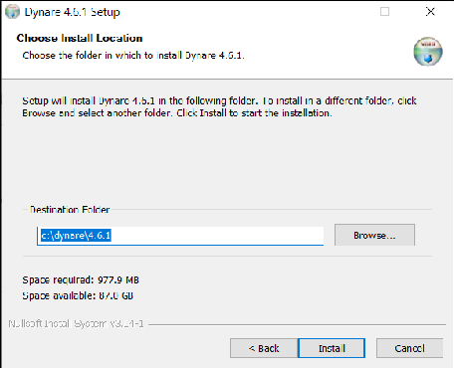
1.2 Installation of Dynare: Windows (4)
Finally, choose a folder in which to install Dynare
You will later need to tell MATLAB the path where Dynare is installed

Slide 9
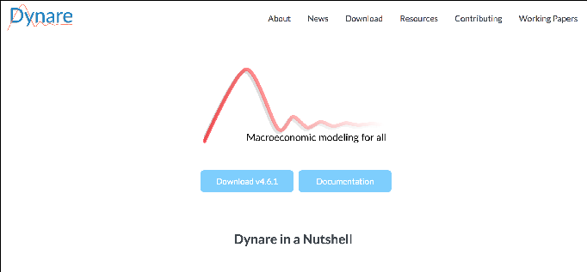
1.3 Installation of Dynare: macOS (1)
Access the Dynare web page (https://www.dynare.org) and click on “Download v4.6.1”:

Slide 10
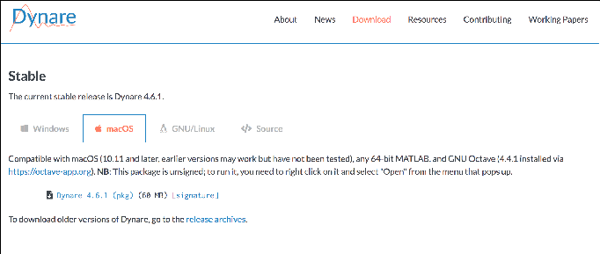
1.3 Installation of Dynare: macOS (2)
The following page will be displayed:
Click on “Dynare 4.6.1 (pkg)” to download the installation package.

Slide 11
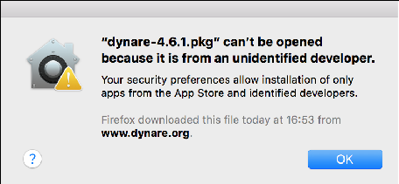
1.3 Installation of Dynare: macOS (3)
Open the downloaded installation package “dynare-4.6.1.pkg”
In case that the following security notification is displayed:
► Access: “System Preferences” –> “Security & Privacy” –> press: “Open Anyway”

Slide 12
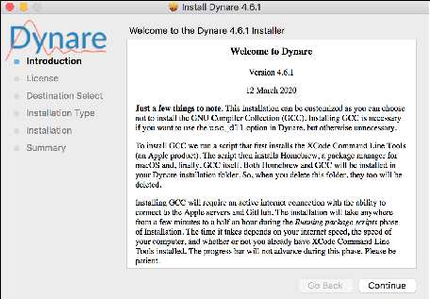
1.3 Installation of Dynare: macOS (4)
The following window should appear:
Follow the displayed instructions.

Slide 13
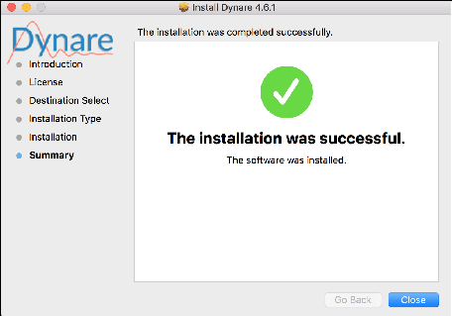
1.3 Installation of Dynare: macOS (5)
If the installation was successful the following window will appear:
The Dynare folder should now be listed under “Applications”.
Dynare is now ready to use and the installation package “dynare-4.6.1.pkg” can be deleted.

Slide 14
Outline
2
Set path to Dynare in Matlab
Set path to Dynare in Matlab: permanently Set path to Dynare in Matlab: temporarily

Slide 15
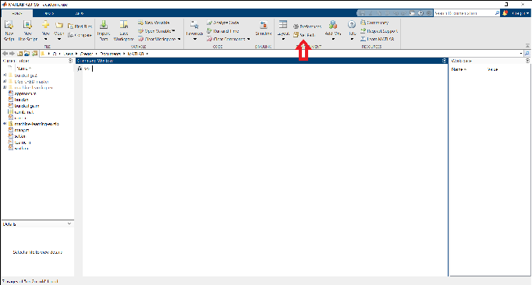
2.1 Set path to Dynare in Matlab: permanently (1)
On the MATLAB Home tab, in the Environment section, click on Set Path

Slide 16
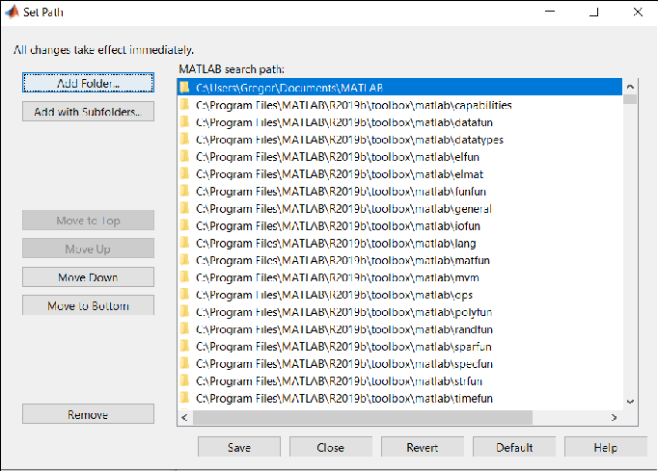
Set path to Dynare in Matlab: permanently (2)
Click Add Folder

Slide 17
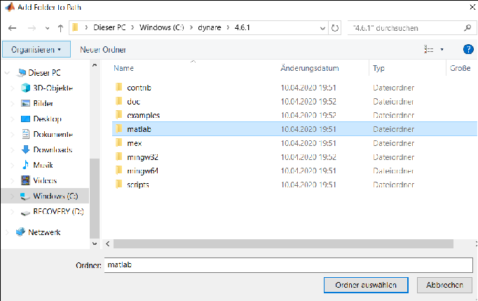
2.1 Set path to Dynare in Matlab: permanently (3)
Select the matlab subdirectory of your Dynare installation
Then select choose folder

Slide 18
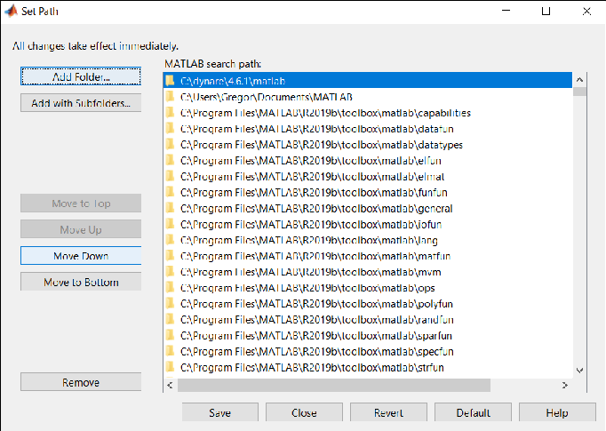
Set path to Dynare in Matlab: permanently (4)
Apply the setting by clicking Save button

Slide 19
2.2 Set path to Dynare in Matlab: temporarily
Alternatively, the path to Dynare can be set temporarily in Matlab
► This allows to switch between different versions of Dynare
The following command has to be entered in Matlab:
► Windows: addpath C:\dynare\4.6.1\matlab
► macOS: addpath /Applications/Dynare/4.X.Y/matlab

Slide 20
Outline
3
Usage of Dynare Examples
Run a Mod File Preprocessor Steady State Results Stability of the Model Output

Slide 21
3.1 Examples
The dynare path contains a folder with examples.
First we need to create a new folder, e.g. NK Baseline Model.
We can copy one of the example mod files and use them.
Note the name is completely arbitrary.

Slide 22
3.2 Run NK_Baseline.mod
Copy the file NK_Baseline.mod and NK_Baseline_steadystate.m into the newly created folder.
Enter the following command in your command window in Matlab:
dynare NK_Baseline
We can copy one of the example mod files and use them.
First, we need to create a new folder, e.g. NK Baseline Model.

Slide 23
3.3 Preprocessor
The command window first shows you that the preprocessor worked fine for our example.
Using 64− b i t preprocessor
S t a r t i n g Dynare ( version 4 . 6 . 1 ) .
C a l l i n g Dynare w i t h arguments : none
S t a r t i n g preprocessing of the model f i l e . . . Found 28 equation ( s ) .
Evaluating expressions . . . done
Computing s t a t i c model d e r i v a t i v e s ( order 1 ) . Computing dynamic model d e r i v a t i v e s ( order 1 ) . Processing outputs . . .
done
Preprocessing completed .

Slide 24
3.4 Steady State Results
The New Keynesian baseline model has a well defined steady state.
STEADY−STATE RESULTS:
d c
. . . .
1
0.40819
The concept of a steady state is defined in the next sessions.
Each endogenous model variable has a corresponding steady state.

Slide 25
3.5 Stability of the Model
Another important issue is the stability of the model.
Dynare has the command check to verify that the model has a unique and stable solution.
EIGENVALUES:
Modulus
Real
Imaginary
1.044 e−13
. . .
I n f
−1.044e−13
−I n f
0
0
There are 15 eigenvalue ( s ) l a r g e r than 1 i n modulus f o r 15 forward−l o o k i n g v a r i a b l e ( s )
The rank c o n d i t i o n i s v e r i f i e d .

Slide 26
3.6 Output
All results are stored in the file NK_baseline_results.mat.
The structure oo_ contains all computation results.
The structure M_ contains the corresponding model setup.
The structure options_ contains the used options.
A folder NK_baseline is created with optional output.

